Slide 1
Managing Holiday Stress
Rony Ngamliya-Ndam and Angie McRae
Healthy New Moms and Children’s Mental Health Matters
Notes:
provide families, clinicians, and community members with practical strategies to manage holiday-related stress, set healthy boundaries, and maintain emotional wellbeing. Participants will learn coping skills, self-care techniques, and ways to support themselves and others during this busy season.

Slide 2
Introductions + favorite holiday foods or activities

Slide 3
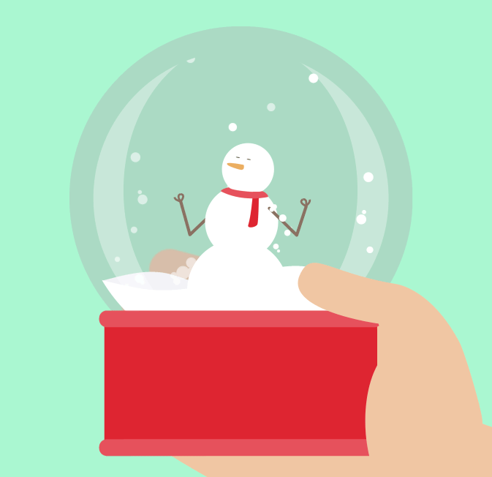
Have you ever felt stressed during the holidays?

Slide 4
What are some holiday stressors?
High expectations
Financial strain
Grief
Loneliness
Disrupted routines
Seasonal Affective Disorder (SAD)
Family conflicts
Pressure to be joyful

Slide 5
Signs & Symptoms of Caregiver Stress
Mood swings: feeling frustrated/ angry one minute and helpless the next.
Trouble focusing, making mistakes when giving medicines.
Smoking or drinking too much alcohol.
Feeling overwhelmed
Feeling alone, isolated, or deserted by others
Sleeping too much or too little
Gaining or losing a lot of weight
Feeling tired most of the time
Losing interest in activities you used to enjoy
Adapted from The Office on Women’s Health Caregiver Stress factsheet

Slide 6
Seasonal or Holiday Stress
Holiday stress can deeply affect parents and caregivers, often bringing feelings of isolation, grief, and increased health challenges.
However, with intentional self-care and coping strategies, it’s possible to reduce stress and promote greater emotional and physical well-being during the season.
Notes:
Challenges Faced by Some During the Holidays
Isolation and Loneliness: Many older adults experience increased feelings of disconnection during the holidays, especially after the loss of loved ones or when living far from family. Prolonged loneliness can heighten the risk of depression and cognitive decline.
Health Concerns: Chronic conditions and physical limitations may make it harder to join in holiday events, leading to frustration, stress, or a sense of inadequacy.
Emotional Strain: The season can stir complex emotions, particularly grief and nostalgia. Memories of past celebrations may intensify sadness or highlight changes in relationships and routines.

Slide 7
Acknowledge your feelings
Every feeling you have is okay. This holiday season may look different based on your current life experience, and whatever you’re feeling is valid.
Allow yourself time to express your feelings.
Journaling
Focusing meditation (https://focusing.org/)
Find peer support – friends, other parents or caregivers

Slide 8
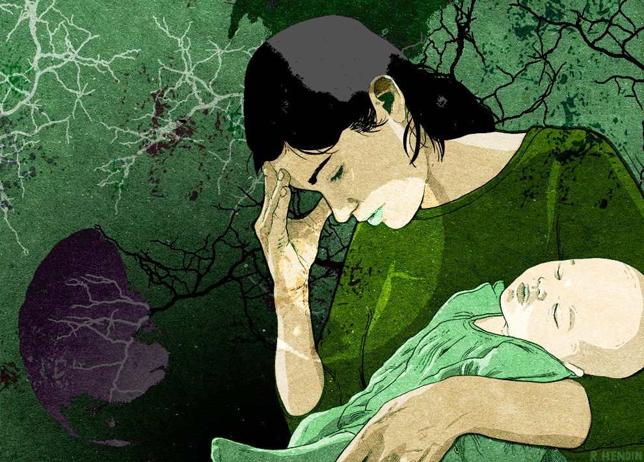
Supporting New and Expecting Moms During the Holidays

Slide 9
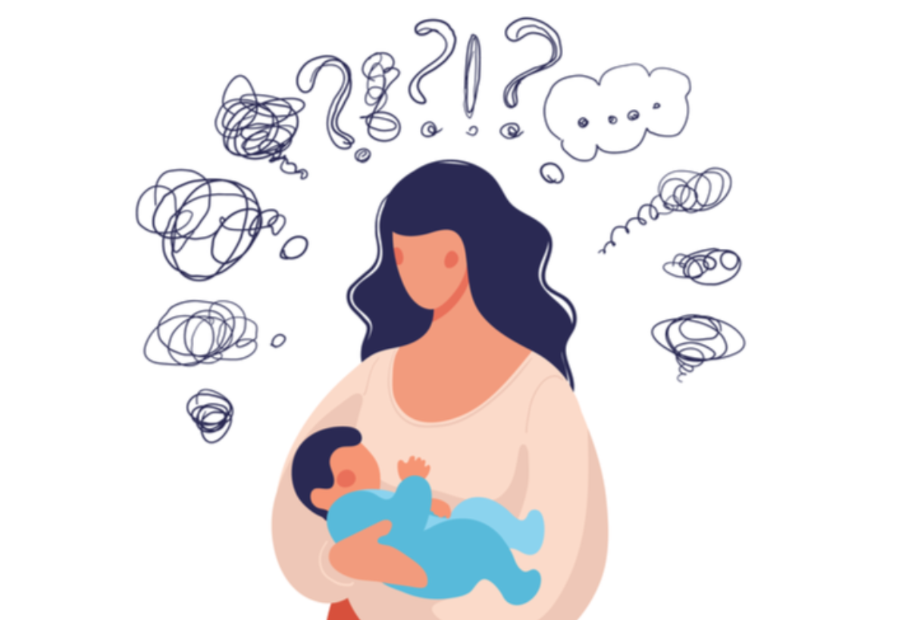
Why the Holidays Can Be Especially Stressful for Moms
Increased expectations to “do it all”
Financial strain and disrupted routines
Pressure to create “perfect” memories
Less sleep and less time for self-care
Family gatherings that may bring conflict, grief, loss, or reminders of past trauma
Notes:
https://positivepsychology.com/gratitude-appreciation/

Slide 10
Encourage support when stress affects daily life, symptoms last over two weeks, or feelings of hopelessness or self-harm arise—seeking help is a sign of strength.
Support Strategies for Moms and When to Reach Out
Lower expectations — “good enough” is enough
Maintain simple routines where possible
Say no without guilt
Build in small moments of rest or joy
Stay connected to at least one supportive person

Slide 11
Encouragement for Parents & Caregivers
Ways to manage your time and priorities:
Create a To-Do List
List all tasks you need or want to accomplish.
Rank each task by priority
Rewrite the list with the highest priority at the top.
Schedule Your Time
Identify available time blocks in your day.
Block time for essential tasks first.
Schedule high-priority tasks next.
Leave space for unexpected events.
Fit in lower-priority or leisure activities last.
End Procrastination
Recognize It: Notice when you’re delaying tasks.
Understand Why: Identify obstacles or fears causing procrastination.
Take Action: Address the issue and move forward with small, concrete steps.

Slide 12
Helping Kids deal with holiday stress
Maintain Routines: Stick to regular bedtimes, mealtimes, and daily rituals to provide security and reduce anxiety.
Schedule Quiet Time: Build in breaks and quiet spots for kids to decompress from busy gatherings.
Prepare for Events: Give kids a heads-up on who's coming and what to expect, so changes don't feel scary.
Encourage Healthy sleep and eating habits - ensure kids stay hydrated and get physical activity.
Limit Overscheduling: Don't pack too many activities in; prioritize meaningful time over constant events.
Model Calm & Gratitude: Show appreciation and focus on being together rather than just gifts.
Breathing & Mindfulness: Simple breathing exercises help when feeling overwhelmed.
Creative Outlets: Drawing, music, or storytelling helps blow off steam.
Bring a favorite toy, book, or blanket to unfamiliar places for comfort.
Movement & Play: Running around or playing sports releases energy. Have a dance party or take a short winter hike!

Slide 13
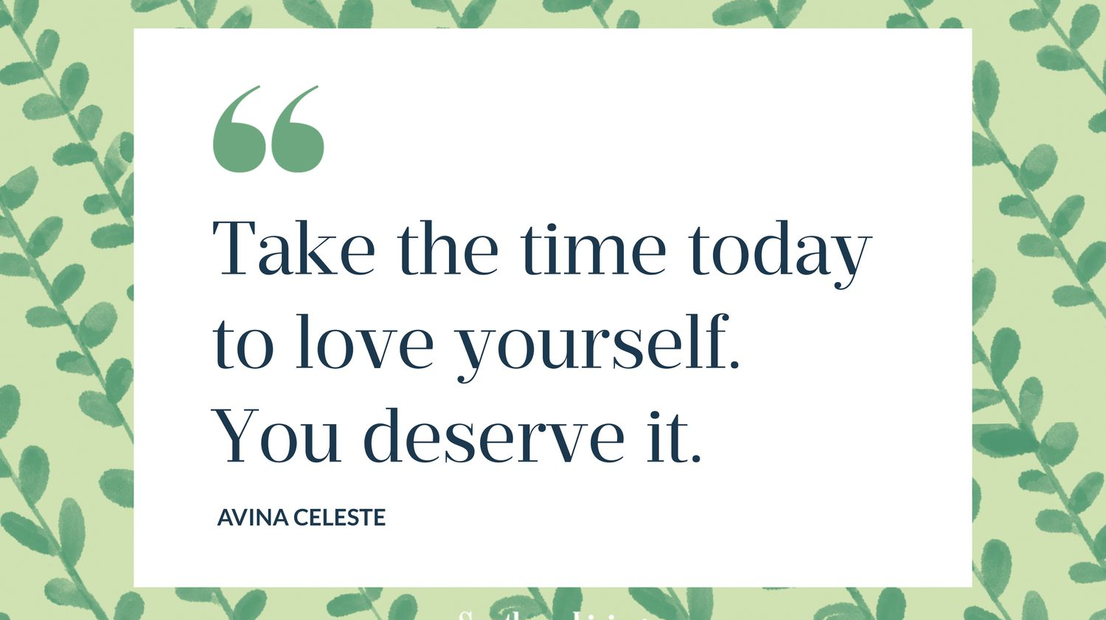

Slide 14
What is Self-Care?
The practice of taking care of physical, mental, emotional, and spiritual aspects of your life to promote health and wellness. While many people may view self-care as a form of selfish indulgence, the act of caring for oneself is an important part of a person's overall well-being.

Slide 15

What are your self-care strategies?

Slide 16

Self-Care Strategies
Healthy Eating
Physical Fitness
Reducing Stress
Time Management
Relaxation Techniques
Mindfulness
Assertiveness
Reading for pleasure
Engaging in a hobby
Creative writing or other creative arts
Therapy
Avoiding media that depicts trauma
Being good to yourself
Getting adequate sleep
Create boundaries
Engage in spiritual activities
Learn how to say “no”
Ask for help
If you’re feeling isolated or lonely, reach out to your support network!

Slide 17
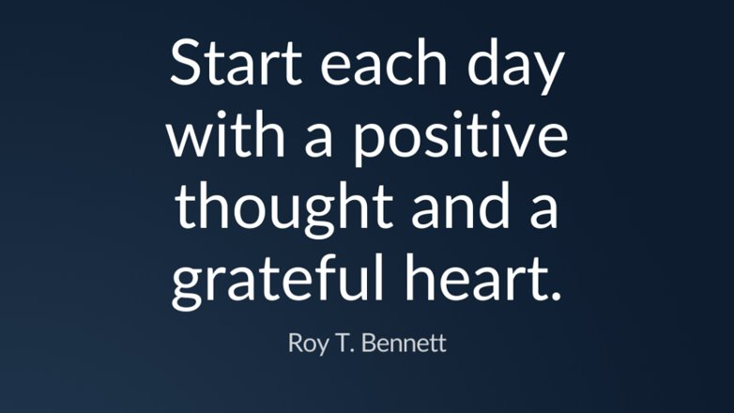
Notes:
One study suggests that practicing gratitude for a few minutes can motivate you to make healthier food choices.

Slide 18
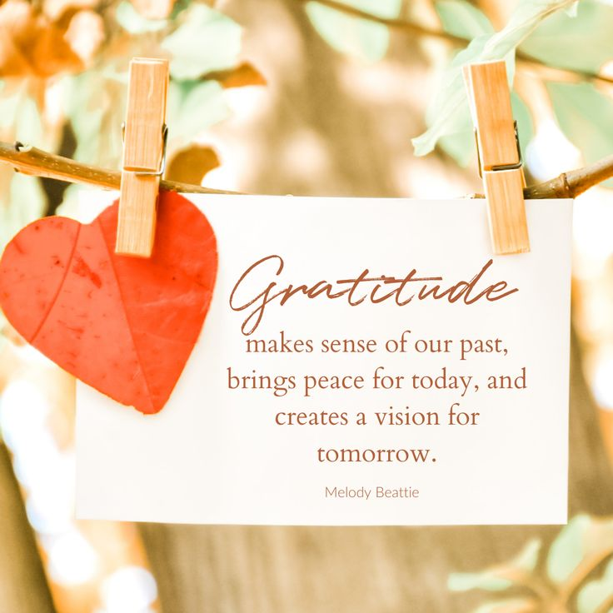
What is Gratitude?
Gratitude is not just a feeling, but a practice that can significantly enhance the well-being of older adults.
It involves intentionally focusing on the positive aspects of life, acknowledging the good things, and expressing appreciation for them.
Notes:
Enhanced well-being – expressing thanks can improve well-being. Grateful people are more agreeable, open and less neurotic
Deeper relationships – those who express gratitude are more willing to forgive and are less narcissistic. Giving thanks promotes relationship formation, maintenance, connection and satisfaction
Improved optimism – People who focus on gratitude are more optimistic about well-being and health
Increased happiness – One study asked participate to write and deliver a letter to someone they were grateful for. Happiness levels and life satisfaction levels increased dramatically, even weeks later
Stronger self-control – self control increases when people choose gratitude over happiness or neutral feelings

Slide 19

Benefits of Gratitude
Enhanced well-being
Deeper relationships
Improved optimism
Increased happiness
Stronger self-control
Notes:
Enhanced well-being – expressing thanks can improve well-being. Grateful people are more agreeable, open and less neurotic
Deeper relationships – those who express gratitude are more willing to forgive and are less narcissistic. Giving thanks promotes relationship formation, maintenance, connection and satisfaction
Improved optimism – People who focus on gratitude are more optimistic about well-being and health
Increased happiness – One study asked participate to write and deliver a letter to someone they were grateful for. Happiness levels and life satisfaction levels increased dramatically, even weeks later
Stronger self-control – self control increases when people choose gratitude over happiness or neutral feelings
https://positivepsychology.com/gratitude-appreciation/

Slide 20
What is one thing you are grateful for this holiday season?

Slide 21
Resources
Free Mindfulness Project
Family Resource Kit
National Maternal Mental Health Hotline: (1-833-TLC-MAMA)
A Caregiver’s Guide to Coping with Stress and Burnout
Mental Health in Later Life Guidebook
Things Mindful Families Do Differently

