Slide 1
BC x MHAMD
August 26, 2025
The JHUSON Birth Companions Program
And Maternal Mental Health
Presented by CJ Twomey

Slide 2

Overview
What is a doula?
The JHUSON Birth Companions Program
Maternal mental health and the perinatal period
Identifying mental health needs
How do I access resources/BC program

Slide 3

What is a doula?
Assists in preparation for birth, labor, and delivery
Physical and emotional presence and support
Holistic care
Education, advocacy, and support
Additional postpartum support (BF, mental health, resources etc.)
Notes:
Doula-mediated comfort measures:
massage, pressure point, focused imagery, positioning, verbal encouragement/mantras

Slide 4
Fewer L&D interventions
25% shorter labors
Doula Impact
Improved pain management
Increased maternal satisfaction
Notes:
decrease in cesarean rates
less oxytocin use
less forceps delivery
60% less epidural requests
30% less analgesia use
Increased early success with BF, infants less likely to have low APGARs, increased confidence, lower incidence in postpartum mood disorders, more affection shown between mother/baby, some evidence of fewer premature births

Slide 5
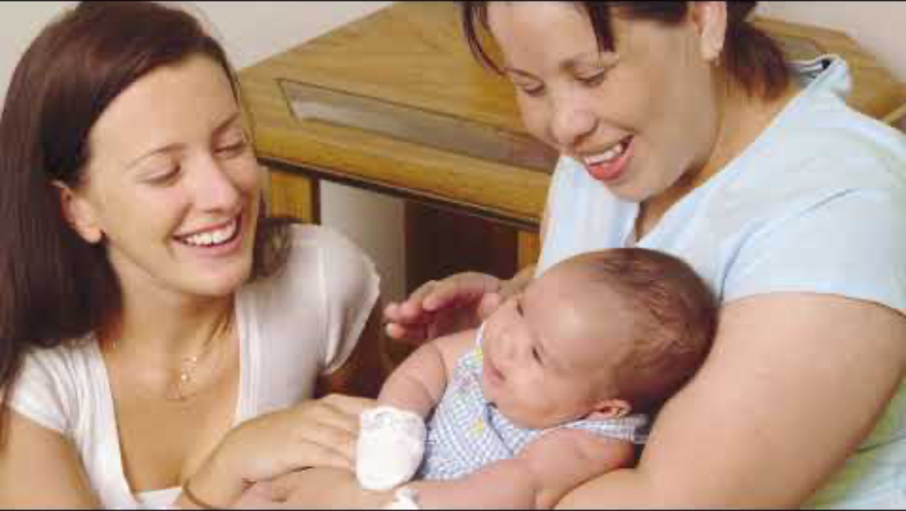

Slide 6

Johns Hopkins University School of Nursing Birth Companions Program
Originated in 1998
Student-led
Free doula services provided to the Greater Baltimore area
Care available in English, Spanish, other languages
No clinical care, adjacent support services only
Process:
  Before: Introduction, identify/address concerns, create a birth plan
  During: Assist, advocate, support
  After: Check in 1-2 days postpartum (feeding, experience, mental well-being, etc.)
Notes:
Not limited to JHH: DC to Annapolis, out in Baltimore County, birth centers

Slide 7


Maternal Mental Health
What
WHO stats
Baby Blues
Postpartum Depression/Anxiety
Postpartum Psychosis
10% of pregnant women
13% of postpartum women
PPD occurs in 1 in 8 women
Negatively impacts mother/baby bonding
Negatively impacts infant well-being
Notes:
baby blues can be normal, "expected abnormal"
Many hormonal changes occur during and immediately after pregnancy

Slide 8

When to seek help
Baby Blues
Mood swings
Tearful episodes
Feeling overwhelmed
Anxiety, irritability
Reduced concentration
Mental Health Concern
Severe mood swings
Crying too much
Severe difficulty caring for yourself or your child (basic ADLs)
Significant decline in appetite, energy, sleep quality
Loss of interest or pleasure in normal activities, “numbness”
Keep in mind:
FMH perinatal mental health concerns increase your risk
Environmental stressors increase your risk

Slide 9

Doula role in maternal mental health
65% lower chance of PPD/Anxiety/PTSD
Inform clients’ understanding of risks, warning signs, & preventative care
Identify perinatal mental health concerns
Role in birth trauma
  Physical and psychological injury during labor & delivery
  Doula presence may influence occurrence/processing of birth trauma
Access and provide resources

Slide 10


son-birthcompanions@jhu.edu
(410) 614-6458
See brochure
Contact with: Name, DOB, delivery date, delivery location/current care
provider, contact info
Accessing BC

Slide 11
BC x MHAMD
August 26, 2025
Thank you!
Questions?

